Slide 1

Unleashing the UPI Revolution: Pioneering Seamless Transactions

Slide 2
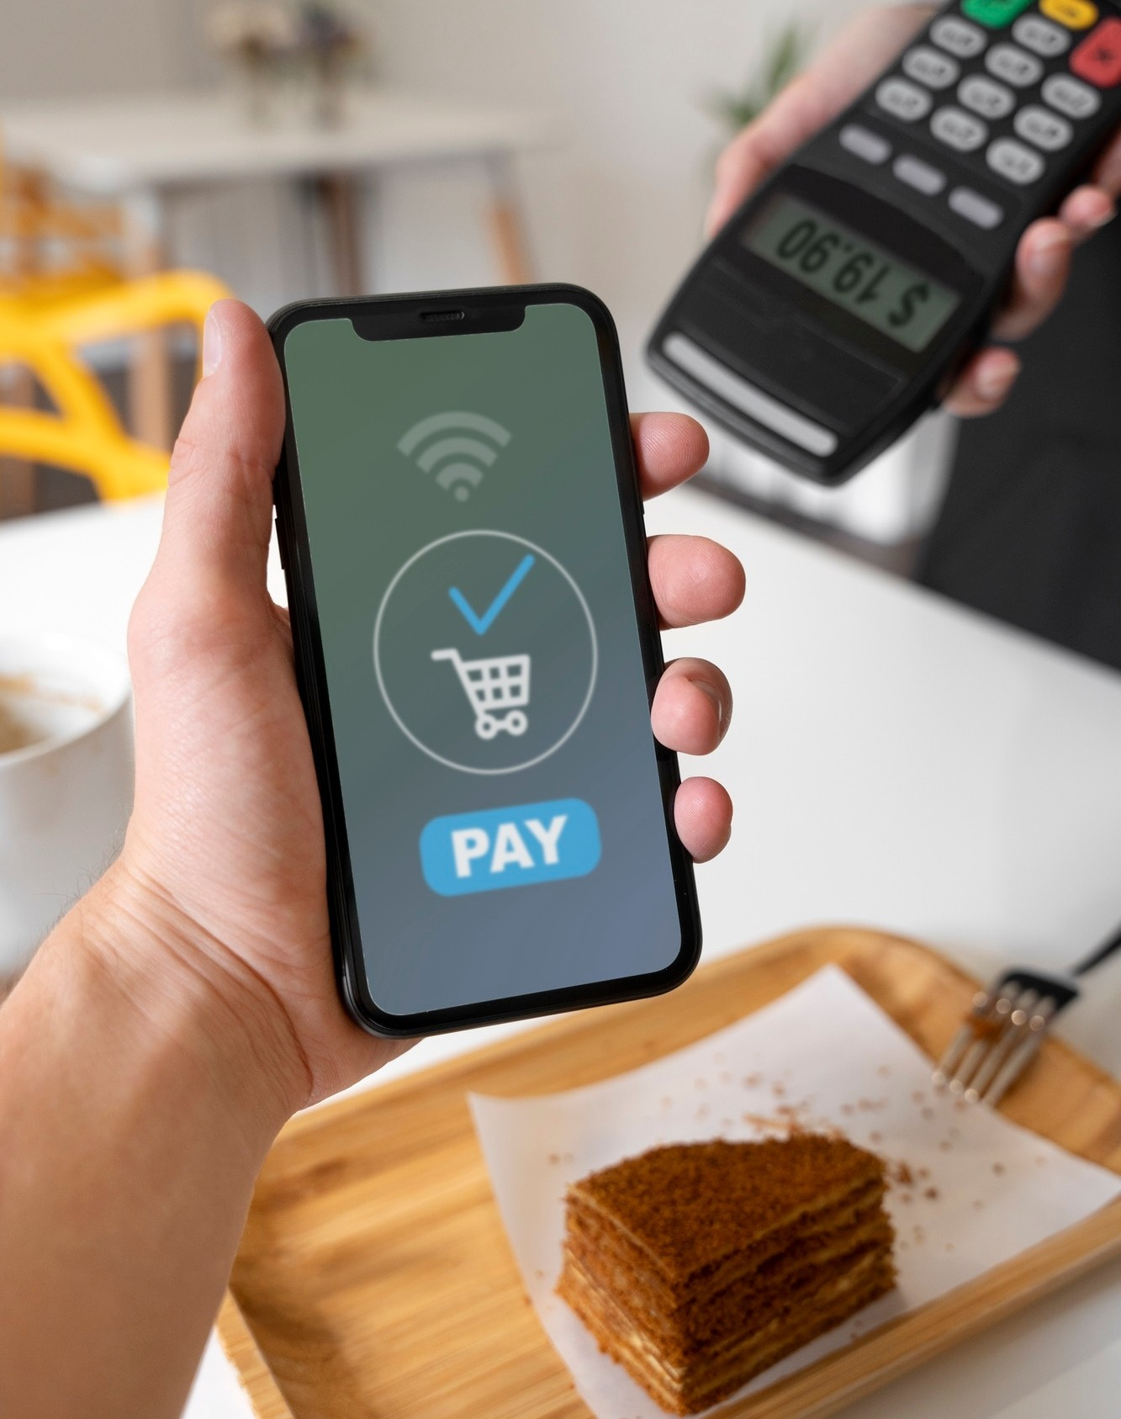
Unleashing UPI
Unleashing UPI revolutionizes digital payments, offering seamless, instant, and interoperable transactions across various banks and payment service providers, empowering users with unparalleled convenience and accessibility in the digital financial landscape.

Slide 3
key Feature of UPI
List of key features : Instant transfers
24/7 availability
Interoperability
Two-factor authentication
Seamless integration with bank accounts

Slide 4
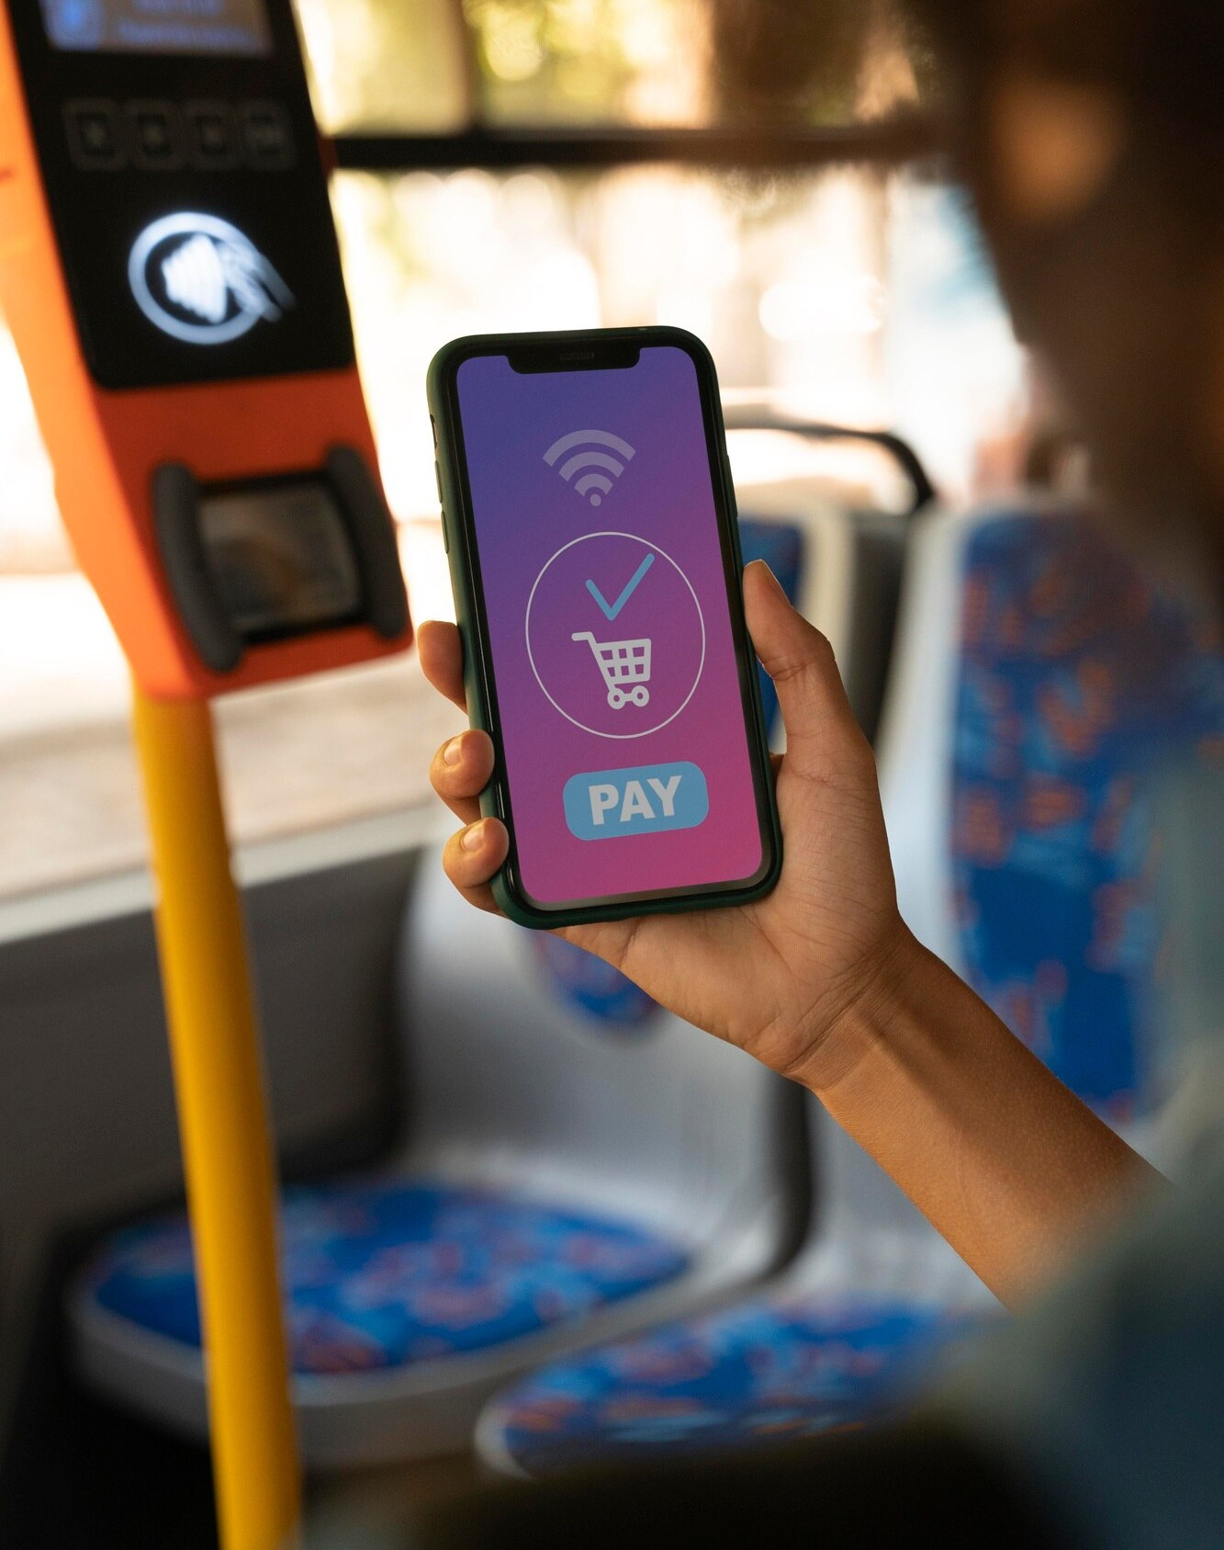
Understanding UPI
Delve into the mechanism of UPI, its role in modernizing payments, and its potential to redeﬁne the way transactions are conducted. Discover the power of UPI in simplifying ﬁnancial interactions.

Slide 5

The UPI Ecosystem
Explore the diverse players in the UPI ecosystem, from banks and payment service providers to merchants and consumers. Uncover the interconnected web that enables seamless transactions.

Slide 6

Innovative Features
Discover the innovative features of UPI that facilitate swift, secure, and convenient transactions. From QR code payments to biometric authentication, witness the evolution of digital ﬁnance.

Slide 7

Enhancing Financial Inclusion
Witness how UPI is empowering the unbanked and underbanked population by providing them with access to digital transactions. See how UPI is breaking barriers and fostering ﬁnancial inclusion.

Slide 8

Security Measures
Uncover the robust security measures embedded within UPI to ensure the safety of transactions. From encryption to multi-factor authentication, learn about the protective layers safeguarding digital payments.

Slide 9
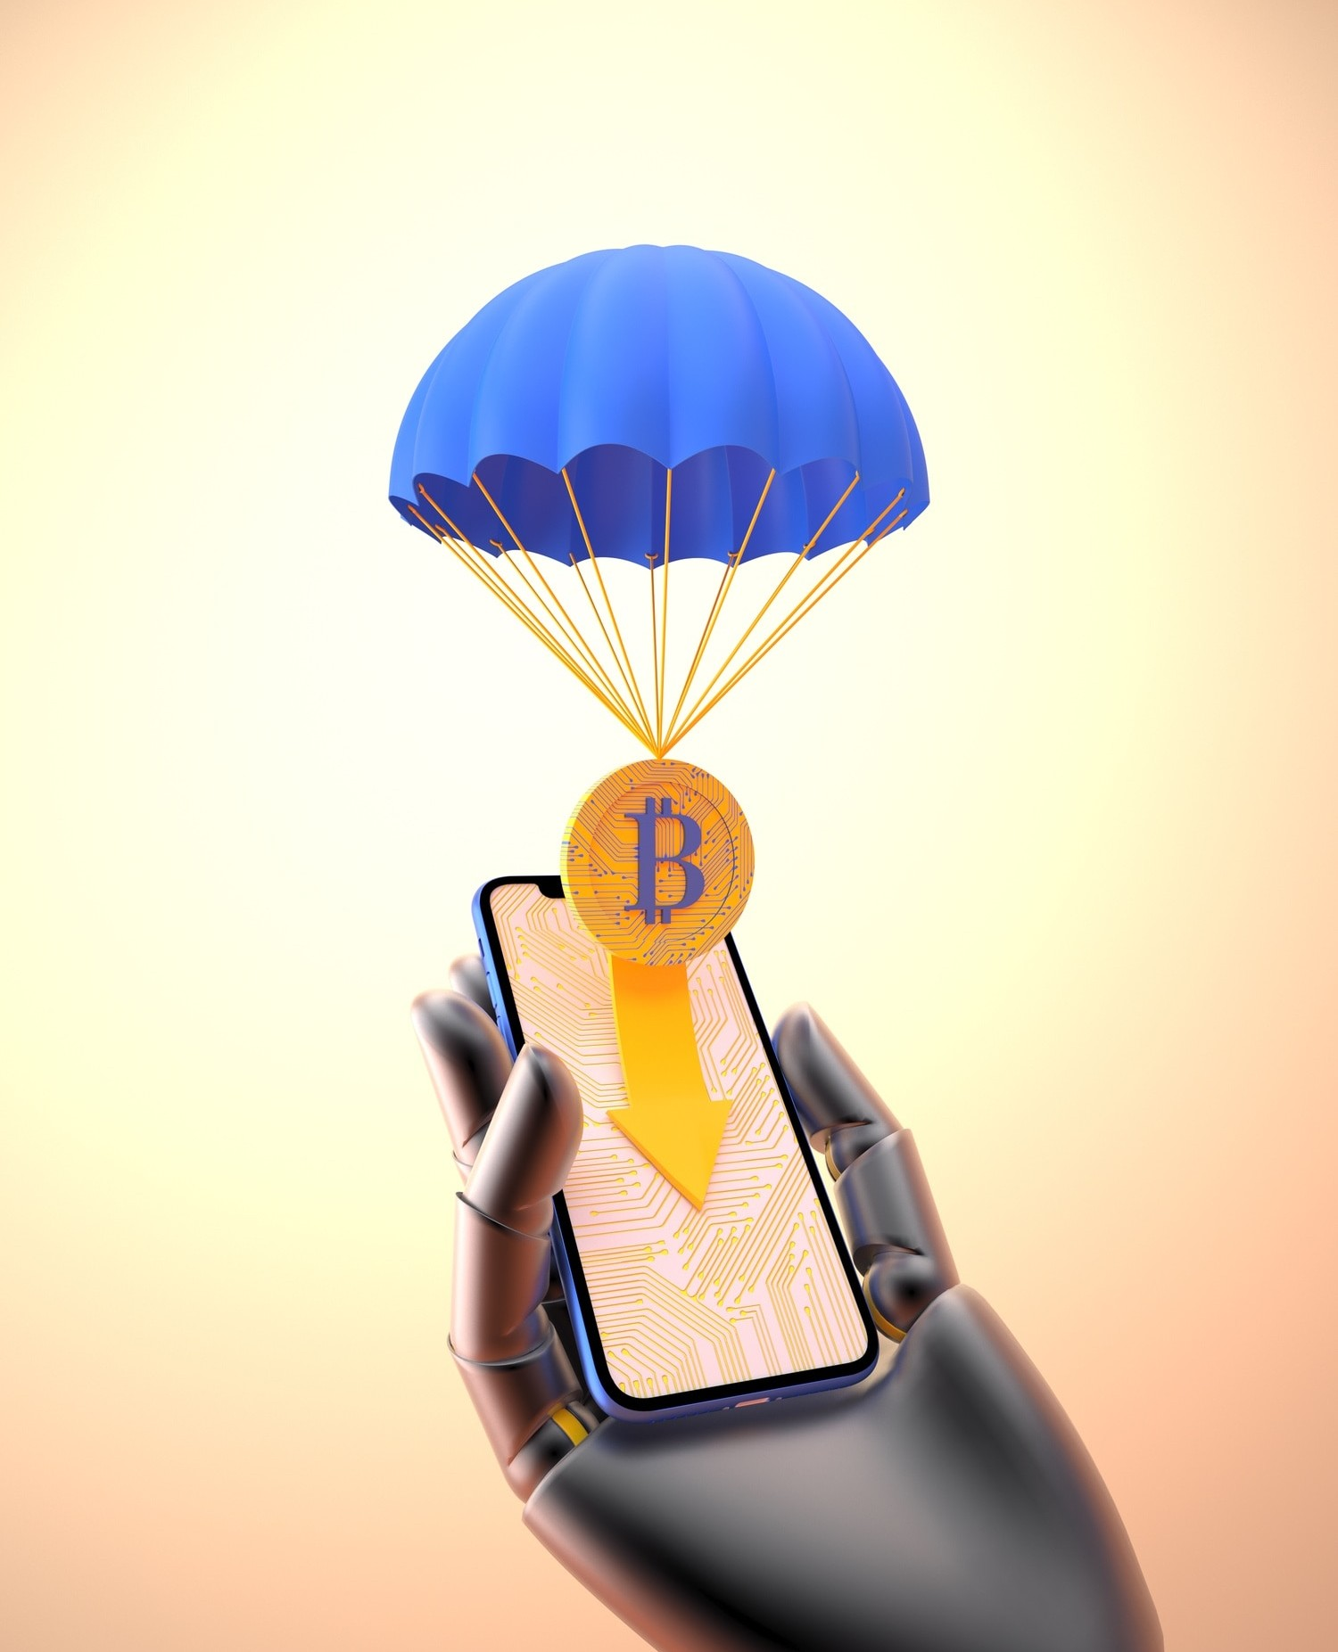
The UPI Impact
Explore the profound impact of UPI on the ﬁnancial landscape, from driving cashless initiatives to streamlining payment processes. Witness the transformative inﬂuence of UPI on the economy.

Slide 10
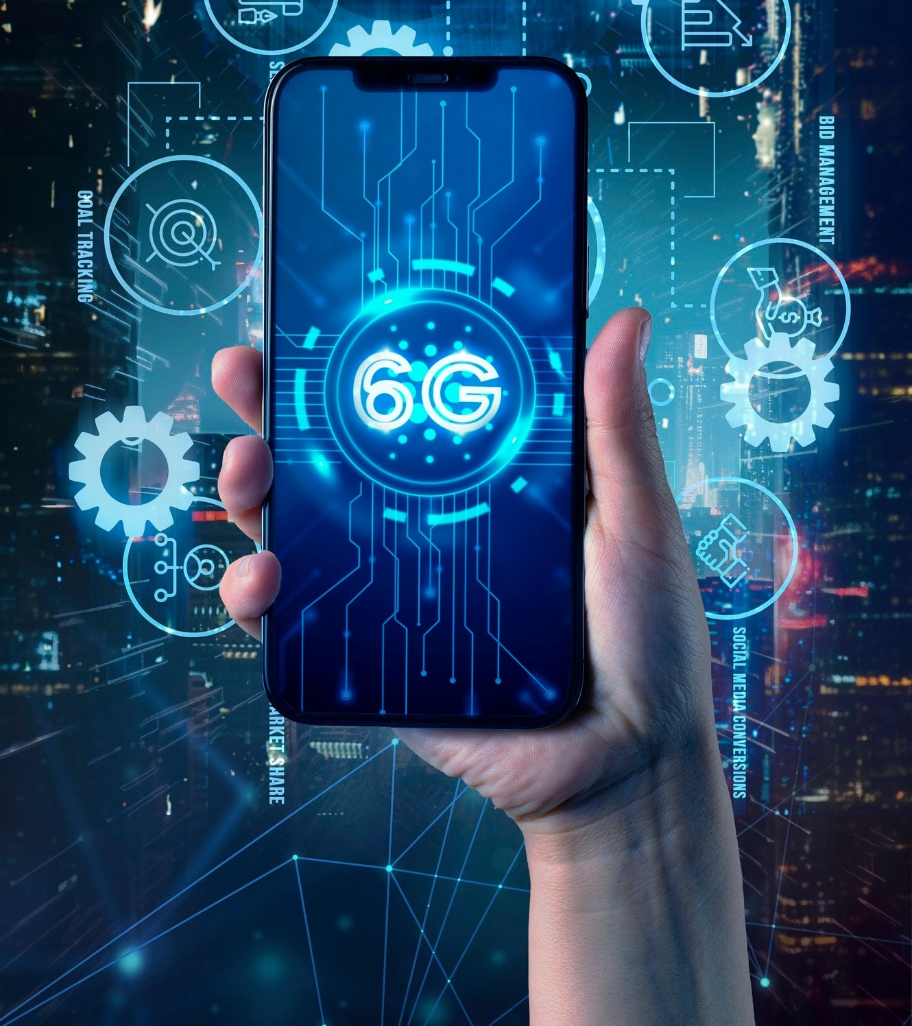
Future Prospects
Peer into the future of UPI and its potential for further evolution.
From interoperability to enhanced user experiences, envision the exciting prospects that lie ahead for UPI.

Slide 11
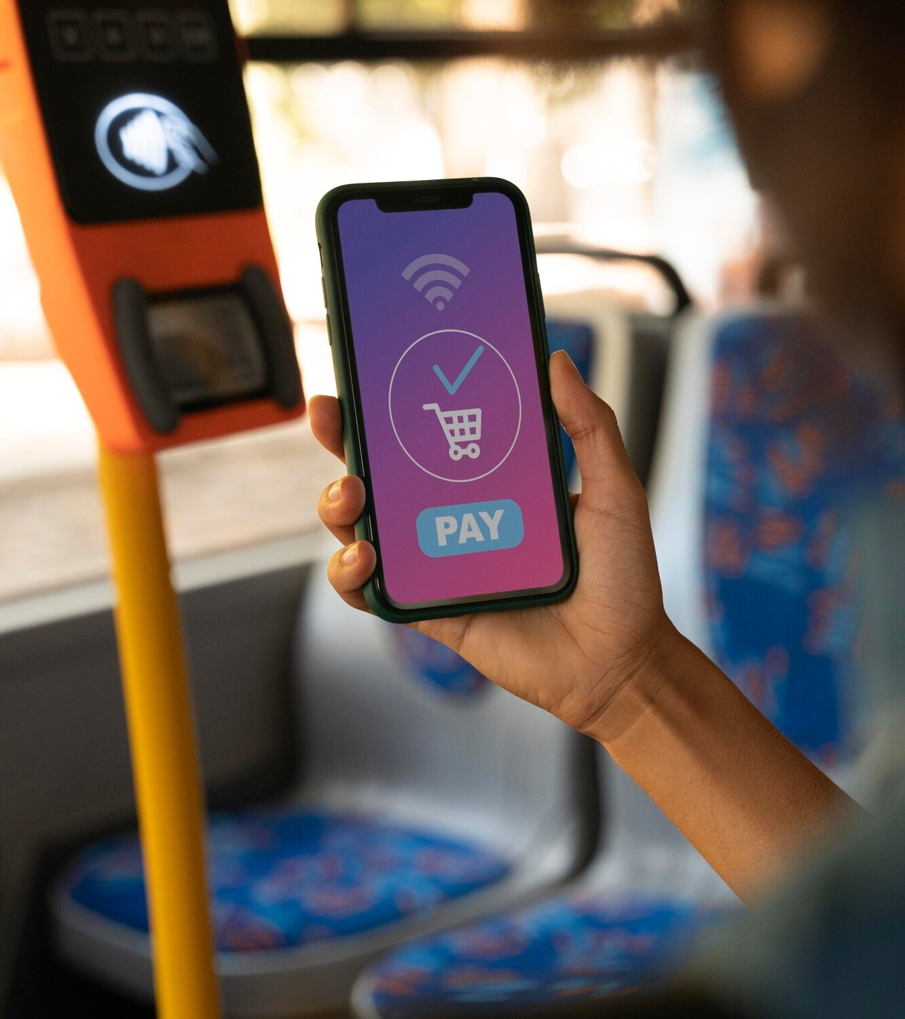
Adoption and Growth
Reﬂect on the remarkable adoption and growth of UPI, witnessing its journey from inception to becoming a cornerstone of digital ﬁnance. Explore the milestones and achievements of
UPI.

Slide 12
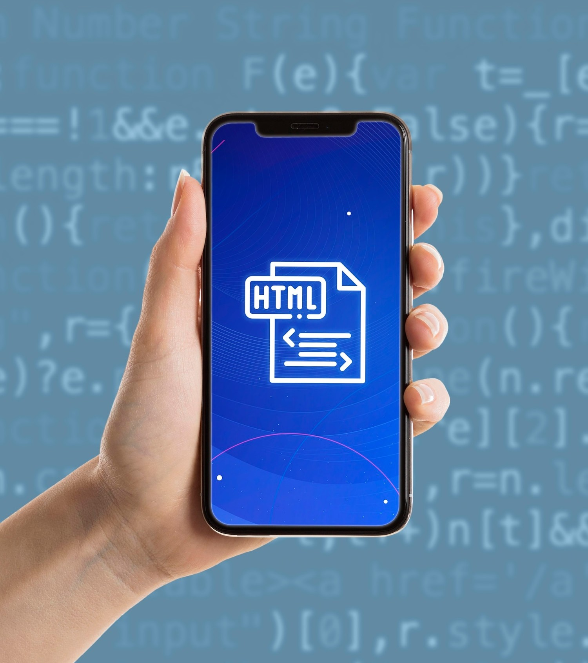
Championing Digital
Transactions
Celebrate UPI as the pioneer of seamless transactions, revolutionizing the way we conduct ﬁnancial interactions. Embrace the era of digital ﬁnance with UPI at the forefront.

Slide 13
Embracing the UPI Revolution
Join the movement and embrace the UPI revolution, as we collectively propel the future of digital ﬁnance. Let's unleash the full potential of UPI and shape a seamless and inclusive ﬁnancial landscape.

Slide 14
Thanks!

